Slide 1

Functional and Non-Functional Needs
Business Intelligence

Slide 2
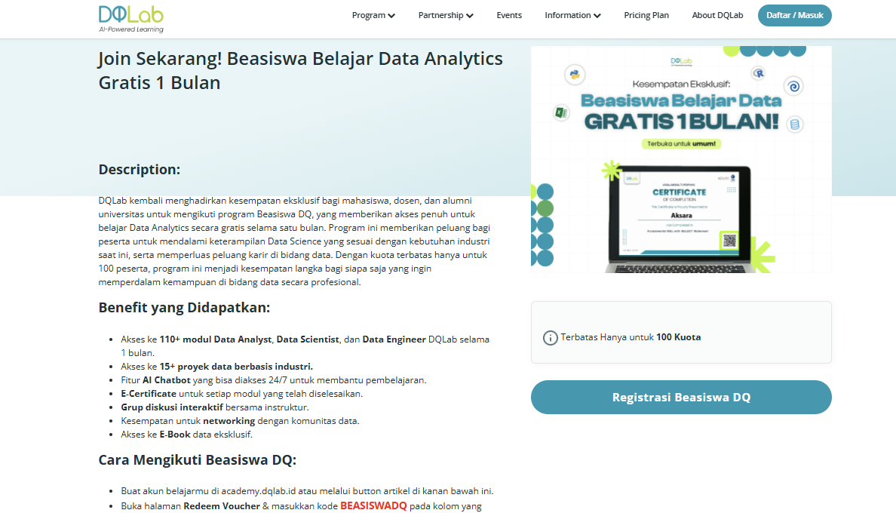
DQLAB COLLABORATION
https://dqlab.id/belajar-data-science-gratis-1-bulan

Slide 3
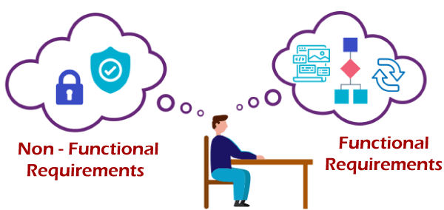
LEARNING OUTCOMES
Students are able to understand the functional and non-functional needs of data warehouses

Slide 4
OUTLINE
Identify business areas
Understand business operations
Defining functional needs
Defining non-functional needs
Feasibility Study

Slide 5
IDENTIFY BUSINESS AREAS
Identification of business areas related to business processes
A business process is a series of activities designed to accomplish strategic goals in an organization (Hollander et al., 2000)
Characteristics of business processes (Sparx system, 2004):
Have a purpose
Have inputs
Has an output
Use resources
Examples of business areas in a data warehouse: sales, resources, inventory
Have an activity procedure
Affects more than one organizational unit
Creating value for consumers

Slide 6
UNDERSTAND BUSINESS OPERATIONS
Business operations are the smallest activity of a business process where the activity focuses on providing goods or services to customers
Examples of business operations in sales business processes:
merchandise marketing,
receipt of orders,
freight forwarding,
payment

Slide 7
FUNCTIONAL NEEDS
Describe the features and functions of the data warehouse, what the system should do, or the services that the system provides to the user in detail
Functional needs areas:
Business requirement: It can be interpreted as a general functional requirement that a company needs to operate. For example: the store wants to record the customer's phone number into the member system
Administrative protocol: functional prerequisites that support the routine operation of a system. For example: monthly reporting
User preferences : Functional prerequisites that help users to operate the software easily. For example: the use of web-based systems that can be accessed in real-time

Slide 8
Functional Needs Area:
System requirement :includes specific actions that the system takes to complete a task and respond in specific circumstances. For example: if the system detects a security breach, it will temporarily deny access to all users
Authentication : Ensures that users validate their identity before executing system functions. For example: assigning a level of access rights to a specific user
Legal Requirements : Some industries require the system to be developed in accordance with regulations (laws that apply in a country). For example: Protecting user identity data
Notes:
Sumber: http://media.infospesial.net/image/p/2016/02/beda-harga-di-rak-dengan-di-kasir-indomaret-dipolisikan-d80b.jpg

Slide 9
NON-FUNCTIONAL NEEDS
Used to direct and restrict the architecture on the system to be built, the purpose of limiting the system to run efficiently
It is not mandatory for a system to have, although this requirement usually improves the quality, speed, and storage capacity
Non-functional needs area:
Usability : Defines how difficult it is for the user to learn and operate the system. For example: providing language usage options
Security : Ensure protection from unauthorized access to systems and stored data. Changing access rights can only be done by administrators

Slide 10
Non-functional needs area:
Reliability : Determine how likely it is that the system can work or fail in a given period of time. For example: the database must be able to rollback when there is an update failure
Performance : Indicates quality attributes that describe the system's response to various user interactions. For example: page load time is no more than 2 seconds for users accessing via mobile networks
Availability: Reflects the time the functionality and service of the system are available for use in all operations. For example: system functionality and data can be accessed 24 hours a day
Scalability : Explain how the system should evolve without negatively impacting its performance. For example: the system can be accessed by more than 200k users at a time
Notes:
Sumber: http://media.infospesial.net/image/p/2016/02/beda-harga-di-rak-dengan-di-kasir-indomaret-dipolisikan-d80b.jpg

Slide 11
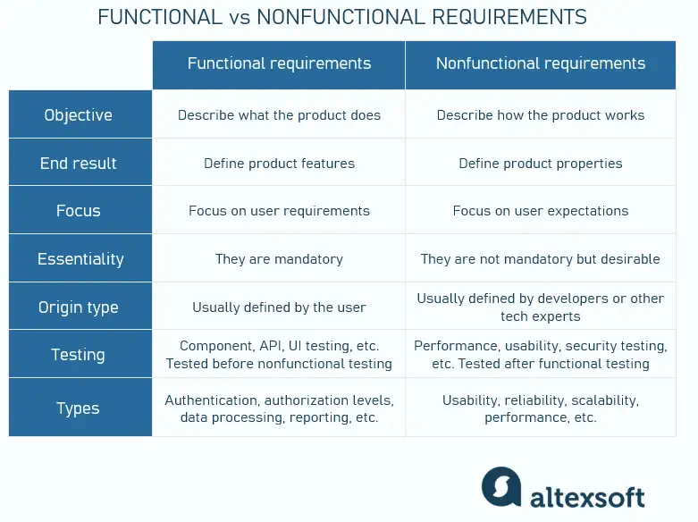
FUNGSIONAL & NON-FUNGSIONAL

Slide 12
FEASIBILITY STUDY
Data feasibility study is the process of exploring the source system, understanding the data by listing the risks on the main data and verifying the list, and determining whether it is possible to deliver the project according to the prerequisites
What was done on the feasibility study:
Source system exploration is to check/test the database platform, database structure, and query table
Understanding data means figuring out where it is for each functional need and understanding the meaning and quality of the data
The risks described in the feasibility study are identified by finding out if there is a "gap" between the needs and the data, or ensuring that the data is available and accessible for each need. Data risk is related to data availability and accessibility.

Slide 13
What was done in the feasibility study (cont.):
Data availability risk is the risk of not being able to meet a requirement due to the unavailability of data For example: a system requirement can display data for 2 years, but only the last 6 months data is available.
Data accessibility risk is the risk of not being able to meet the requirements because the ETL system cannot extract data and put it into the data warehouse. For example: we may not be able to identify updates to the table because there is no "last update" timestamp, because we are not allowed to install trigger updates in the source table, and because the table is too large to extract in its entirety at any time
Notes:
Sumber: http://media.infospesial.net/image/p/2016/02/beda-harga-di-rak-dengan-di-kasir-indomaret-dipolisikan-d80b.jpg

Slide 14
CASE STUDY (RAINALDI, 2008)
Amadeus Entertainment is a global online and offline retailer that sells music, movies, and audio books with stores in 8 countries. The stakeholders in this case study are Grace (business owner), David (data warehouse designer), Natalie (Project Manager).
They met with various managers and directors from each department and discussed business operations and the problems faced. Visit several stores and talk to store managers and employees to learn details about how business processes run in the stores. Visit the online store office to view product categories and order processes
Grace and David trace and understand business operations in each area and try to understand the processes, roles, and problems in each area, then map out events, statuses, levels, and roles

Slide 15
Event : It is an activity that occurs repeatedly every few specified periods. For example: in the sales section, there is a document called a purchase order. The document contains a request to the supplier (a music record company) to supply the company with some products (CD or MP3 songs). Every week Amadeus Entertainment creates hundreds of these documents and sends them to several suppliers. Another example of an event is the purchase of records by customers or the download of songs in an online store.
Status :Is the condition of an object at a certain point in time. For example, subscription status can be subscribed, unsubscribed
Level : It is the quantitative measurement of an object at a certain point in time. For example, the number of customers, account balance, inventory level
Roles : Is who is involved in an event. For example, the roles in the purchase order are suppliers, account managers, and products
Notes:
Sumber: http://media.infospesial.net/image/p/2016/02/beda-harga-di-rak-dengan-di-kasir-indomaret-dipolisikan-d80b.jpg

Slide 16
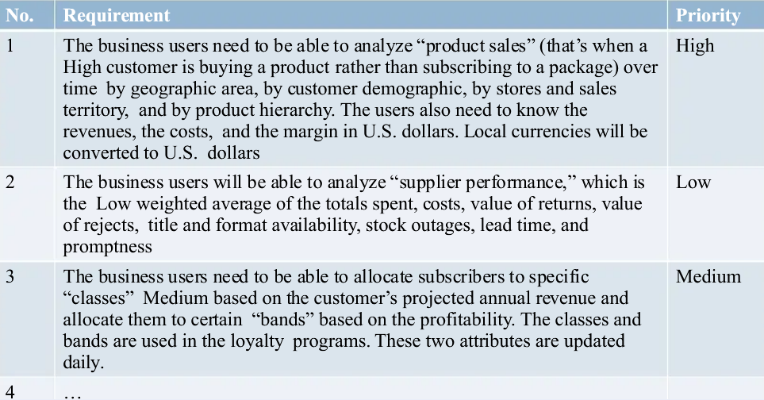
DEFINING FUNCTIONAL NEEDS
After understanding the business operations in each area, Grace discussed the functional needs, namely the features and functionality of the data warehouse
What can the system do? They agree that the Amadeus Entertainment data warehouse has the functionality shown in the following table:
Notes:
Sumber: http://media.infospesial.net/image/p/2016/02/beda-harga-di-rak-dengan-di-kasir-indomaret-dipolisikan-d80b.jpg

Slide 17
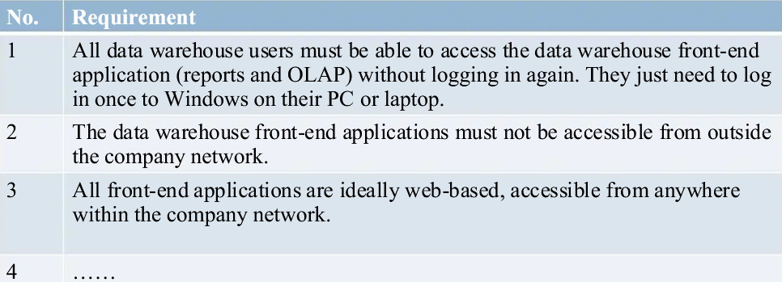
DEFINING NON-FUNCTIONAL NEEDS
Meet with the IT architecture and operations team to describe non-functional needs
Notes:
Sumber: http://media.infospesial.net/image/p/2016/02/beda-harga-di-rak-dengan-di-kasir-indomaret-dipolisikan-d80b.jpg

Slide 18
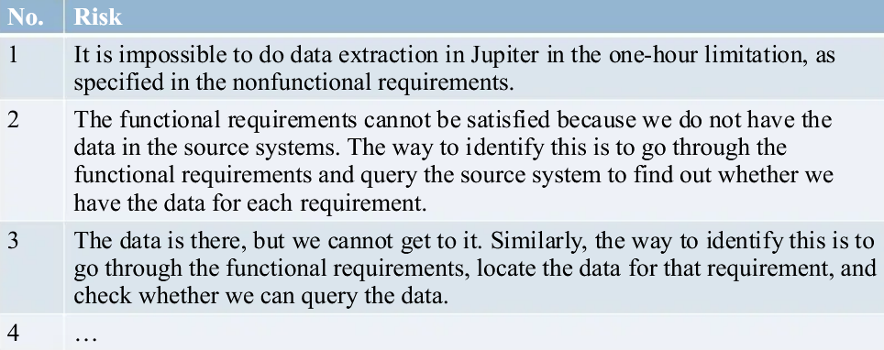
CONDUCTING A FEASIBILITY STUDY
After defining functional and non-functional needs, a feasibility study data is carried out and the following risks are defined
Notes:
Sumber: http://media.infospesial.net/image/p/2016/02/beda-harga-di-rak-dengan-di-kasir-indomaret-dipolisikan-d80b.jpg

Slide 19
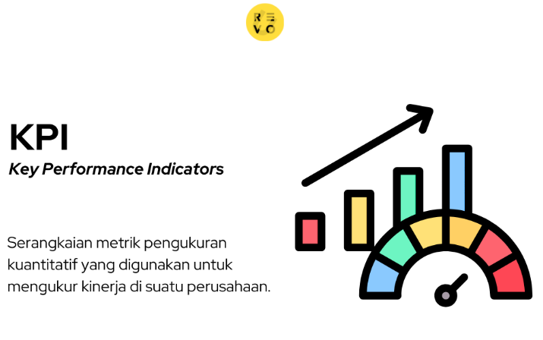
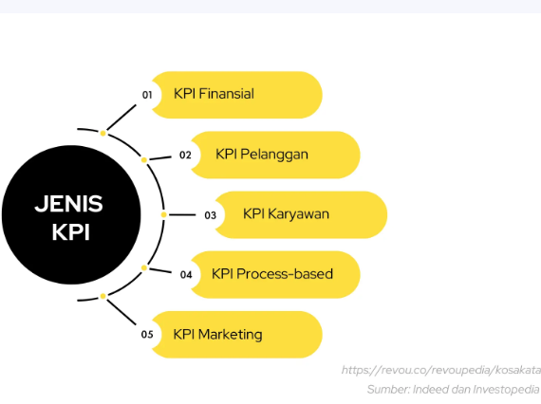
https://revou.co/kosakata/kpi

Slide 20
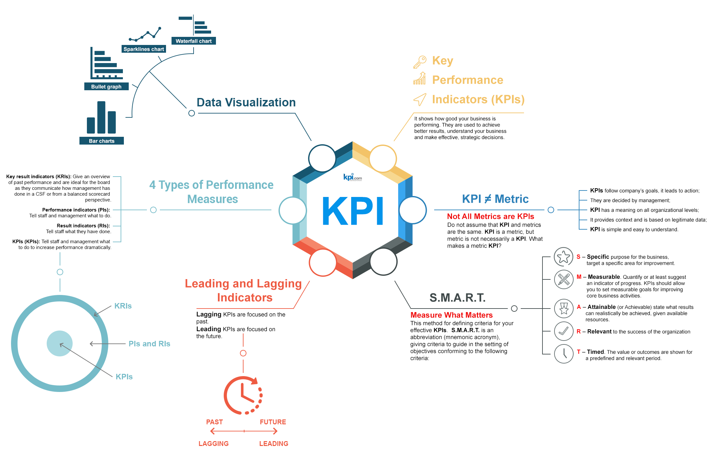
KPI

Slide 21
group assignment (5 people)
Find 1 example case study and describe the functional and non-functional needs of the datawarehouse

Slide 22


